Slide 1

Beta 2 Demo Scorecard Refresh for SIL
Presented by:
Data Science
January 2025

Slide 2
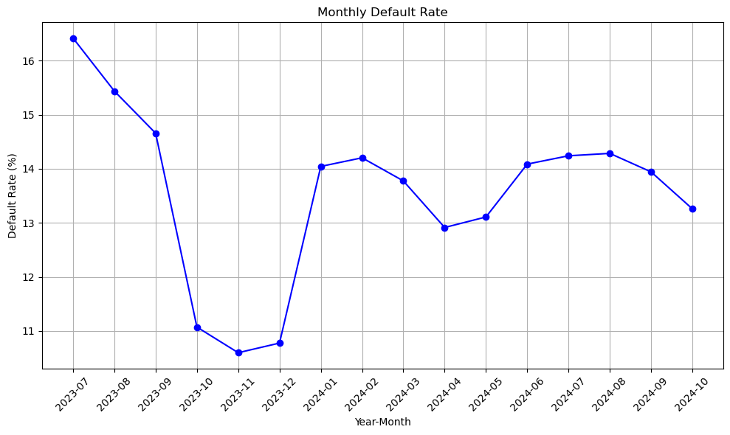
 | Loan Disbursement Date | # All SIL Loans |  |  | # Bad (FSPD30) SIL Loans |  |  | FSPD30 rate
 |  | Overall | Mobile | Non Mobile | Overall | Mobile | Non Mobile | Overall |  | Mobile | Non Mobile
All Data Training – 90%,val – 10% | 01/07/2023 - 30/06/2024 | 57244 | 3093 | 54151 | 7484.0 | 596.0 | 6888.0 | 0.1307 | 0.1926 |  | 0.1271
July | 01/07/2024 - 31/07/2024 | 11253 | 2559 | 8694 | 1607.0 | 515.0 | 1092.0 | 0.1428 | 0.2012 |  | 0.1256
Aug | 01/08/2024 - 31/07/2024 | 14274 | 4100 | 10174 | 2041.0 | 754.0 | 1287.0 | 0.1429 | 0.1839 |  | 0.1264
Sep | 01/09/2024 - 30/09/2024 | 14375 | 4283 | 10092 | 2006.0 | 810.0 | 1196.0 | 0.1395 | 0.1891 |  | 0.1185
Oct | 01/10/2024 - 25/10/2024 | 10945 | 3074 | 7871 | 1482.0 | 597.0 | 885.0 | 0.1354 | 0.1942 |  | 0.1124
SIL Loan FSPD30 rate over the months

Slide 3
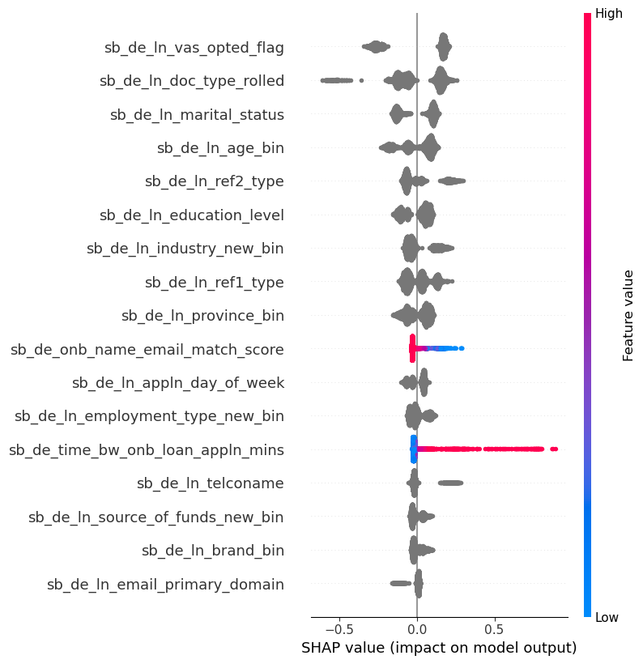
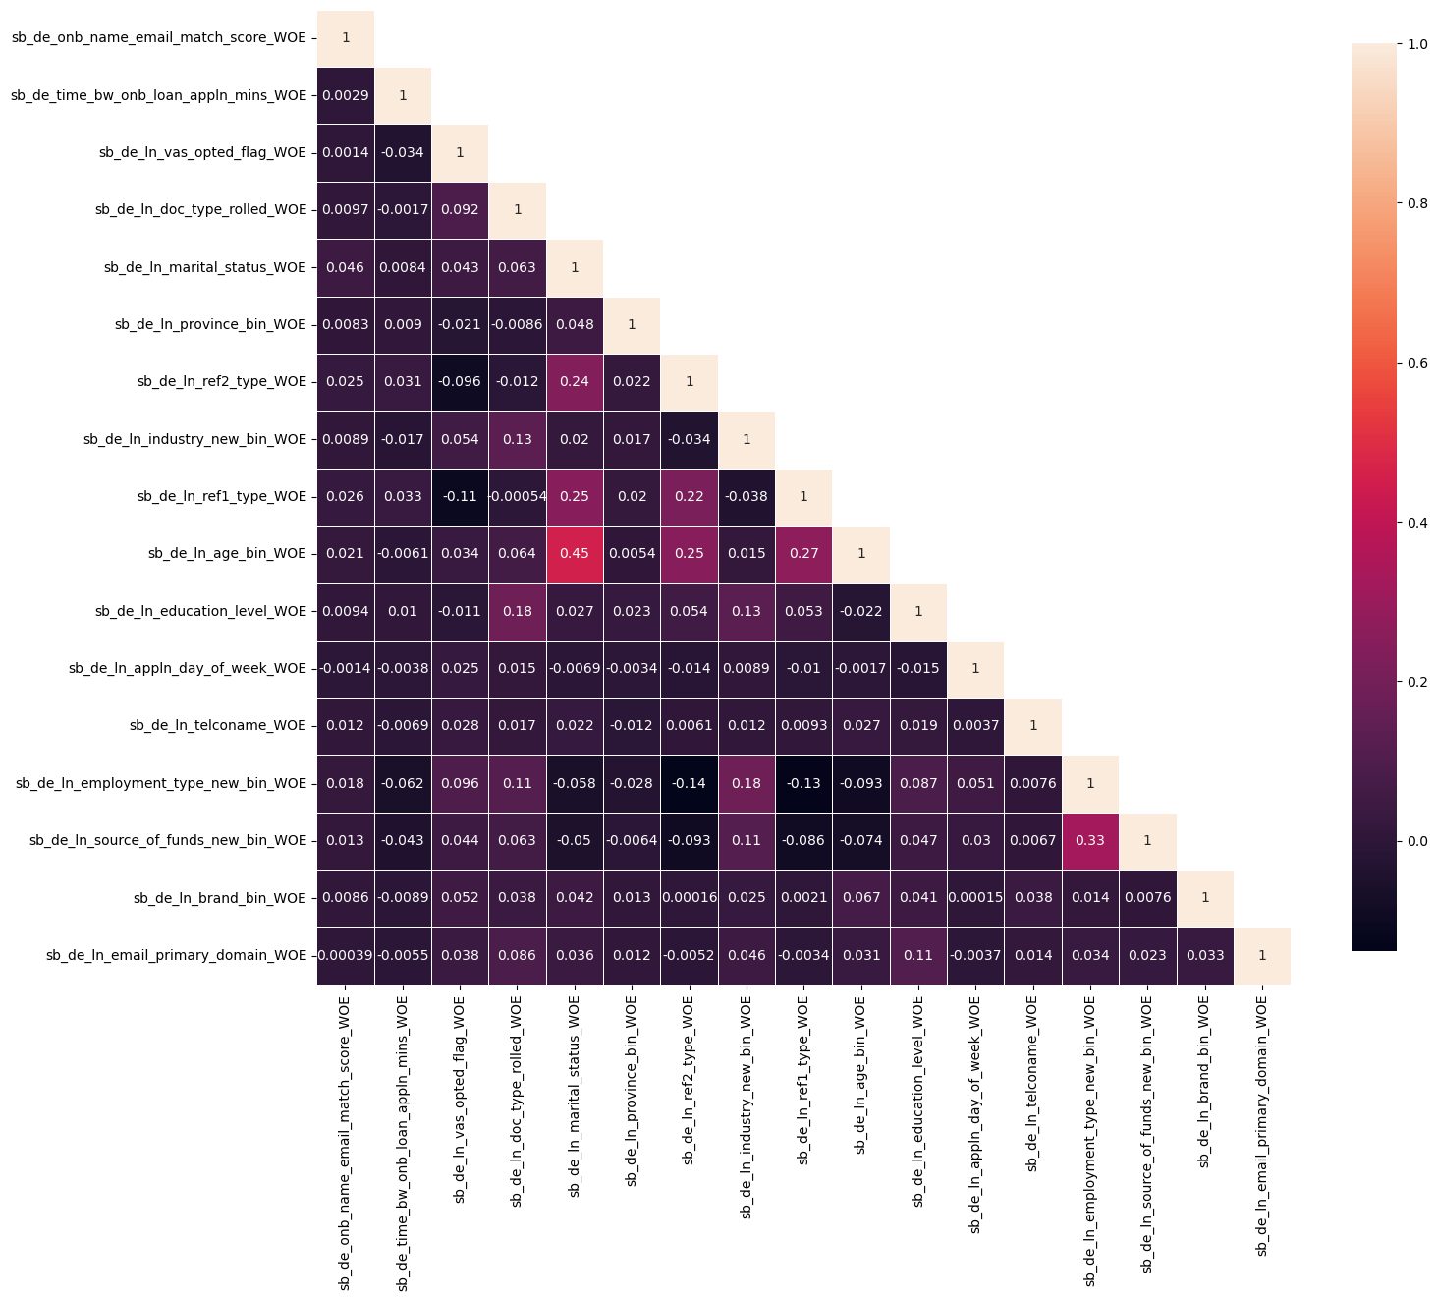
Top 17 Feature Performance

Slide 4
Top 17 Feature Description (1 of 3)
Feature Name | Feature Description
sb_de_ln_vas_opted_flag | ln_ prefix means the feature is taken from Loan Journey unless the feature name is obviously from Loan Journey. This feature means whether the user has opted for any value-added services like PayHinga (that allows payment holidays) during the loan application process
sb_de_ln_doc_type_rolled | Type of KYC document uploaded by the customer. We aggregated similar categories into one, e.g. Driving License type 2018 and Driving License type 2022 would be combined into Driving License etc.
sb_de_ln_marital_status | Marital status of the loan applicant: single/ married/ widow etc.
sb_de_ln_age_bin | Age of the applicant, used binning for better handling of outliers
sb_de_ln_province_bin | Province from the Address given during loan application
sb_de_ln_education_level | Education level given during loan application
sb_de_ln_ref2_type | Every loan applicant needs to give Two References: their names, contact details and relationship with those references. This feature is the relationship type of the loan applicant with the 2nd Reference
sb_de_ln_ref1_type | This feature is the relationship type of the loan applicant with the 1st Reference
sb_de_ln_industry_new_bin | We used the new Industry Descriptions for this provided by Dj and Mel. Basically, in our modeling dataset we replaced the old Industry Description name with the new Industry Description name. However, there are some completely new Industry Descriptions that DJ and Mel introduced which were never there before in our dataset. During inferencing those completely new ones will get mapped into a category called 'new'. After 4-5 months we will need to retrain this model to allocate them into proper industry description bins.
sb_de_ln_appln_day_of_week | Which day of week the user applied for the loan (Mon/Tue/ Wed/Thu/Fri/Sat/Sun)

Slide 5
Top 17 Feature Description (2 of 3)
Feature Name | Feature Description
sb_de_ln_telconame | name of the Telco provider based on the Mobile number. Now in Loan application we do NOT ask the user to re-enter their Mobile number, but we ask them to enter one additional mobile number. This telconame is extracted from the primary mobile number given by the customer.
sb_de_ln_employment_type_new_bin | We used the new Employment Type for this provided by Dj and Mel. Basically, in our modeling dataset we replaced the old Employment Type name with the new Employment Type name. However, there are some completely new Employment Types that DJ and Mel introduced which were never there before in our dataset. During inferencing those completely new ones will get mapped into a category called 'new'. After 4-5 months we will need to retrain this model to allocate them into proper Employment Type bins.
sb_de_onb_name_email_match_score | This feature calculated the similarity matching score between users (firstname |middlename | lastname) and the first part of their email addresses and choose the max score. Usually risky users does not give their names in their emails and vice versa. So high match score means lower risk, and low match score means higher risk.
sb_de_ln_brand_bin | Means the device manufacturing brand of the loan applicant. E.g. Apple/ Samsung/ Oppo etc.
sb_de_ln_source_of_funds_new_bin | We used the new Source funds for this provided by Dj and Mel. Basically, in our modeling dataset we replaced the old Source funds name with the new Source funds name. However, there are some completely new Source funds that DJ and Mel introduced which were never there before in our dataset. During inferencing those completely new ones will get mapped into a category called 'new'. After 4-5 months we will need to retrain this model to allocate them into proper Source funds bins.

Slide 6
Top 17 Feature Description (3 of 3)
Feature Name | Feature Description
sb_de_ln_email_primary_domain | This feature have the primary domain of user email id (E.g. gmail/yahoo/outlook etc)
sb_de_time_bw_onb_loan_appln_mins | For SKYC users from the beginning: Time between TSA onboarding time (Customer ID creation time) and the Loan Application Submission time in mins. For BKYC users who upgraded to SKYC users: Time between BKYC to SKYC Upgrade time and the Loan Application Submission time in mins. This adjustment was done to take into account that BKYC users cannot apply for a loan, they can apply only after they are upgraded to SKYC.

Slide 7
Model Performance wrt FSPD30
 | 01/07/2023 - 30/06/2024 |  | Test (July) Gini |  |  | Test (Aug) Gini |  |  | Test (Sep) Gini |  |  | Test (Oct) Gini
 | Train Gini (90%) | Val Gini (10%) | Overall | Mobile | Non Mobile | Overall | Mobile | Non Mobile | Overall | Mobile | Non Mobile | Overall | Mobile | Non Mobile
Old Model retrained with the same features Bins (Logreg – v0) (In Production from April 2024 – 11th Dec 2024) | 0.1450 | 0.1533 | 0.1350 | 0.0555 | 0.1620 | 0.1338 | 0.0778 | 0.1573 | 0.1320 | 0.0818 | 0.1660 | 0.1301 | 0.0892 | 0.1629
Retrained with same feature but changed features Bins (Logreg) – v1 (In production from December 2024) | 0.1581 | 0.1756 | 0.1289 | 0.0920 | 0.1363 | 0.1368 | 0.1123 | 0.1434 | 0.1021 | 0.0548 | 0.1281 | 0.1052 | 0.1027 | 0.1082
Current 17 feat Model (Catboost) – v2 | 0.3392 | 0.2627 | 0.2663 | 0.2141 | 0.2925 | 0.2554 | 0.2232 | 0.2790 | 0.2643 | 0.1967 | 0.3050 | 0.2691 | 0.2195 | 0.2980

Slide 8
APPENDIX 1 : Distribution of the Features used in the New Model

Slide 9
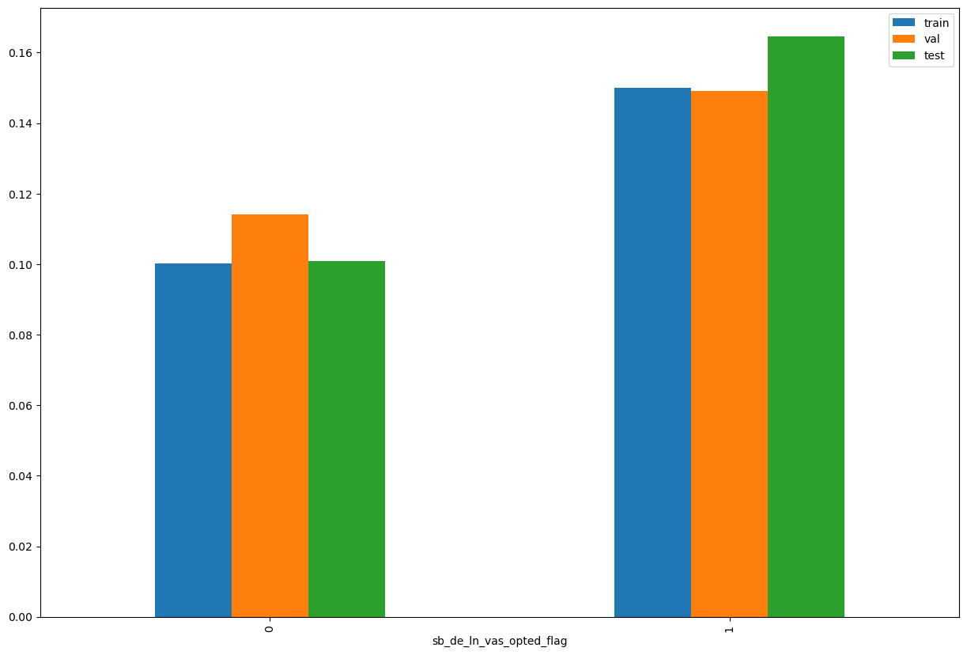

sb_de_ln_vas_opted_flag

Slide 10
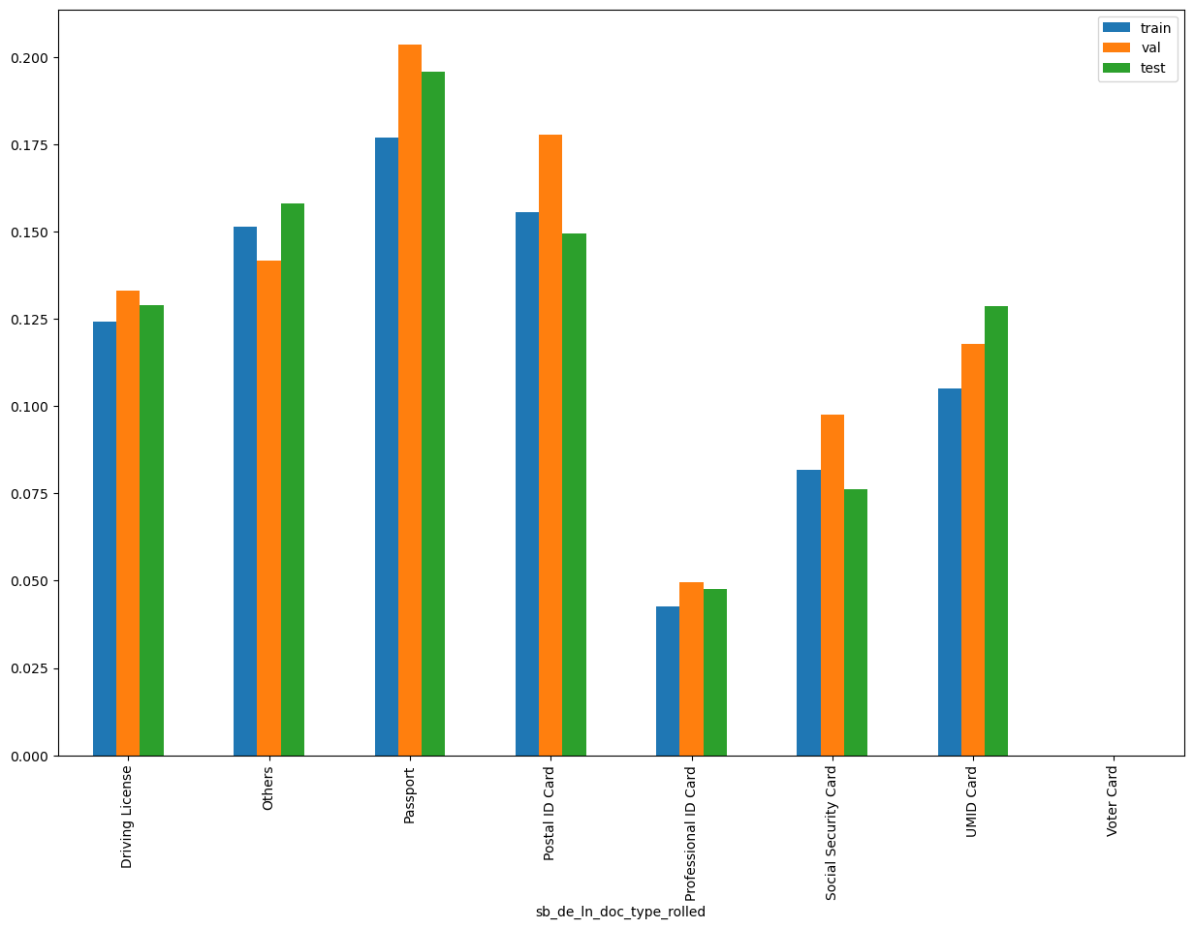
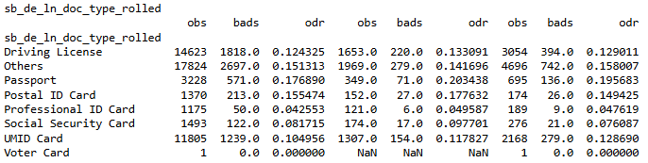
sb_de_ln_doc_type_rolled

Slide 11
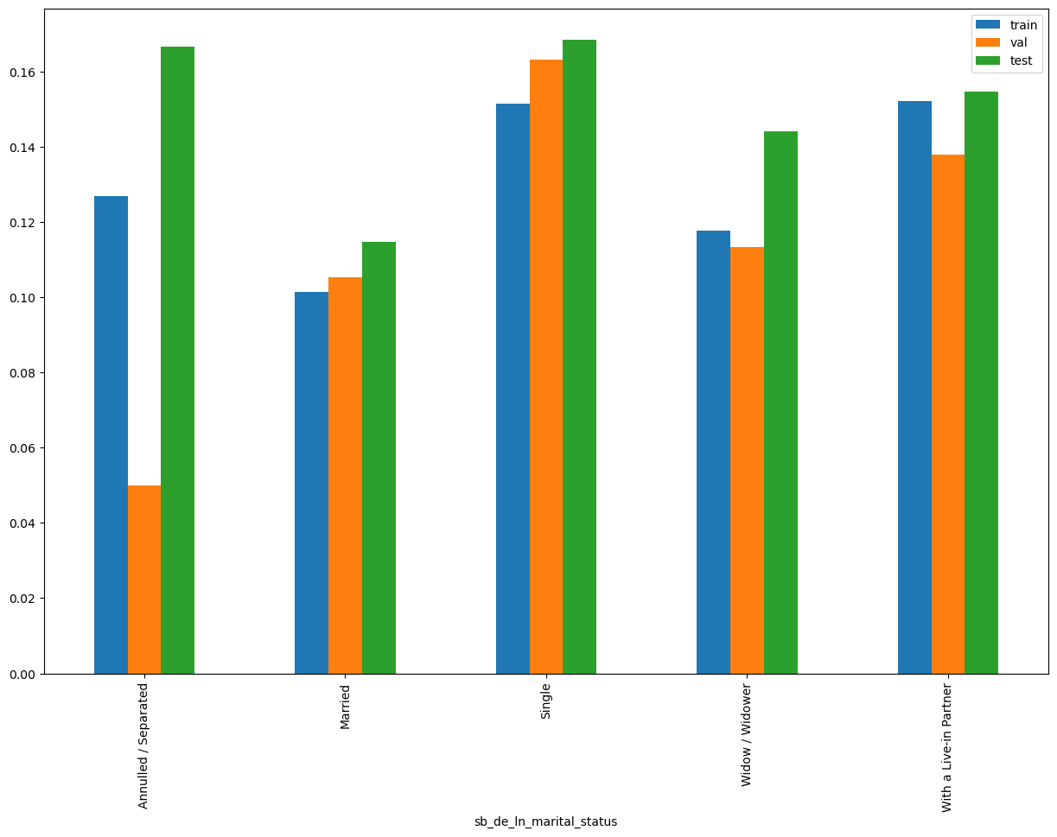
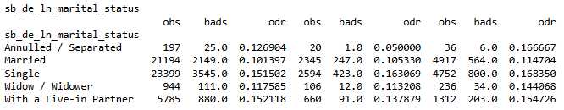
sb_de_ln_marital_status

Slide 12
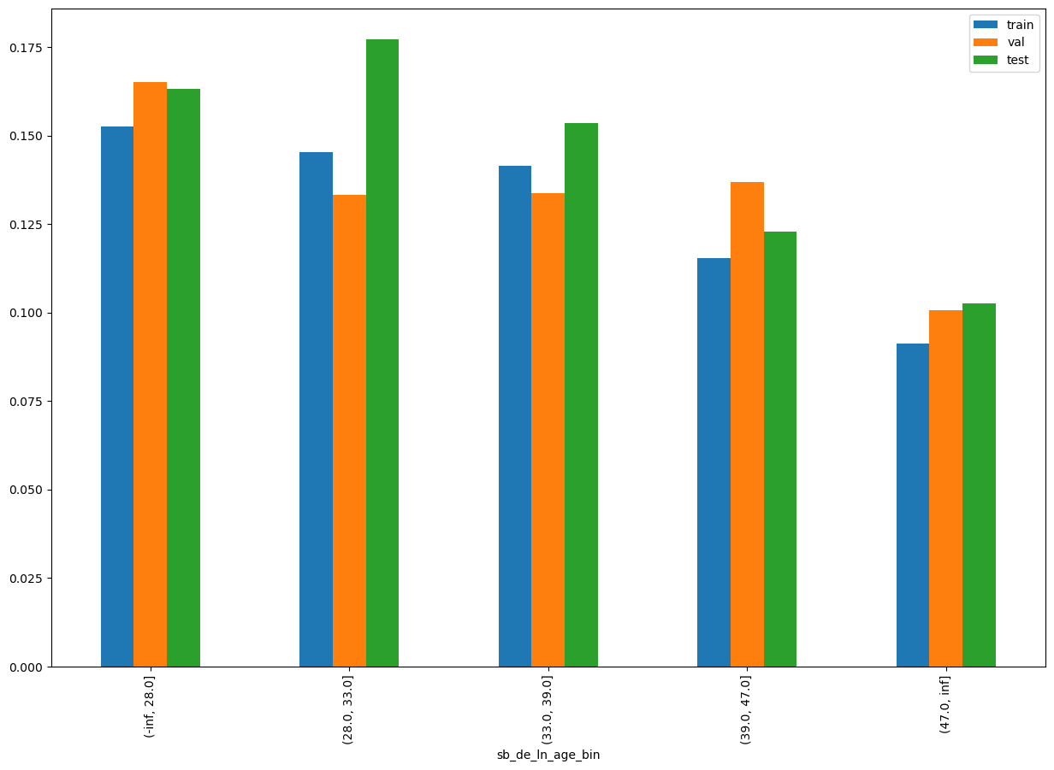
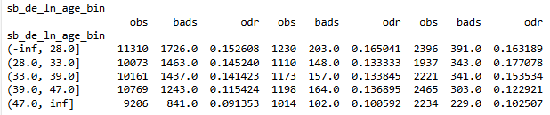
sb_de_ln_age_bin

Slide 13
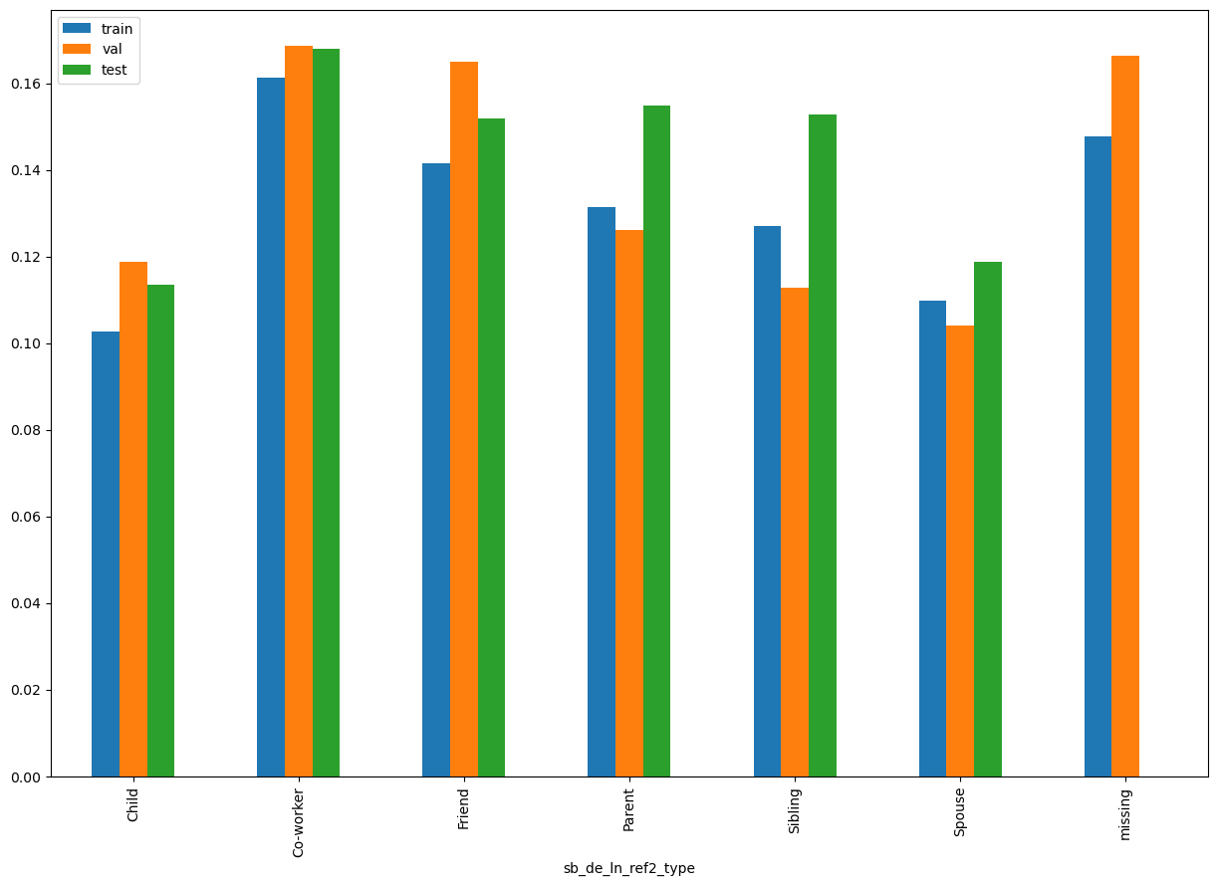
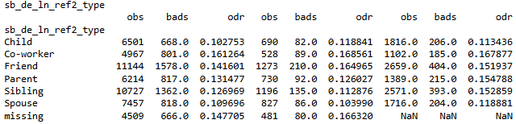
sb_de_ln_ref2_type

Slide 14
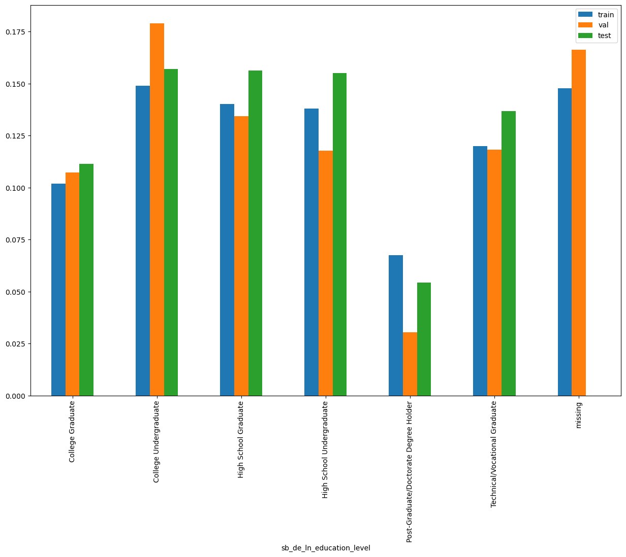
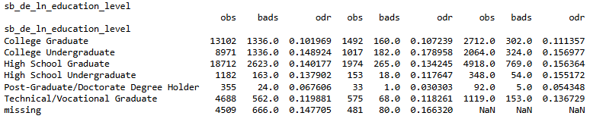
sb_de_ln_education_level

Slide 15
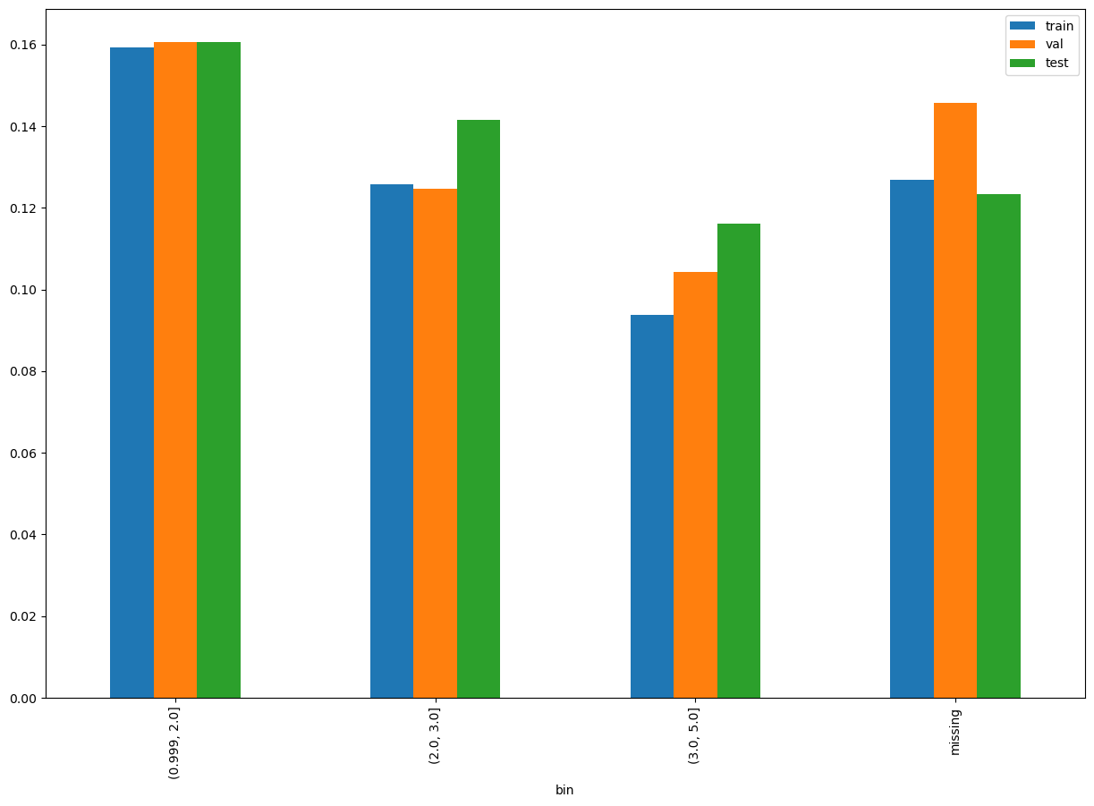
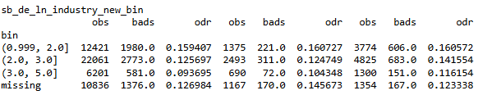
sb_de_ln_industry_new_bin

Slide 16
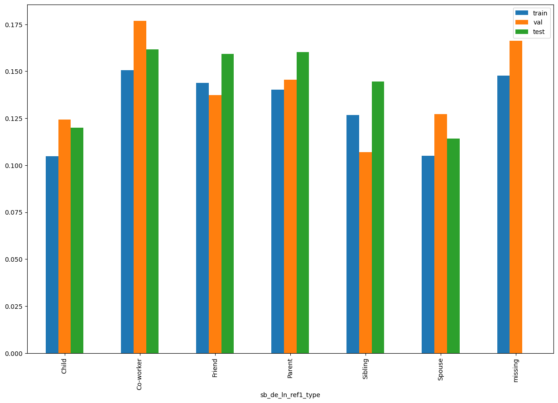
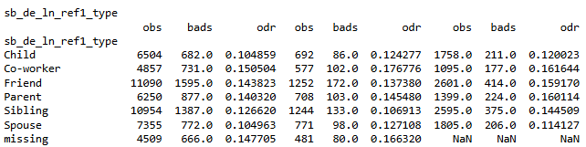
sb_de_ln_ref1_type

Slide 17
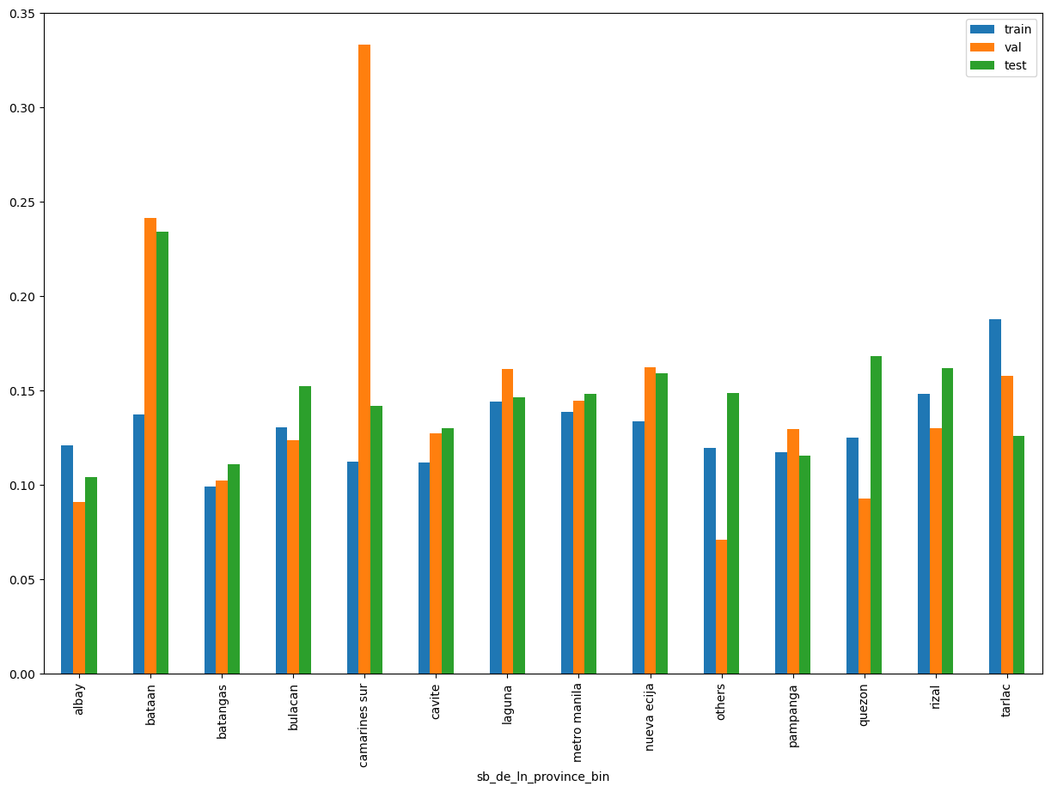
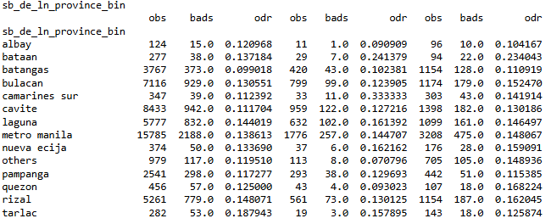
sb_de_ln_province_bin

Slide 18
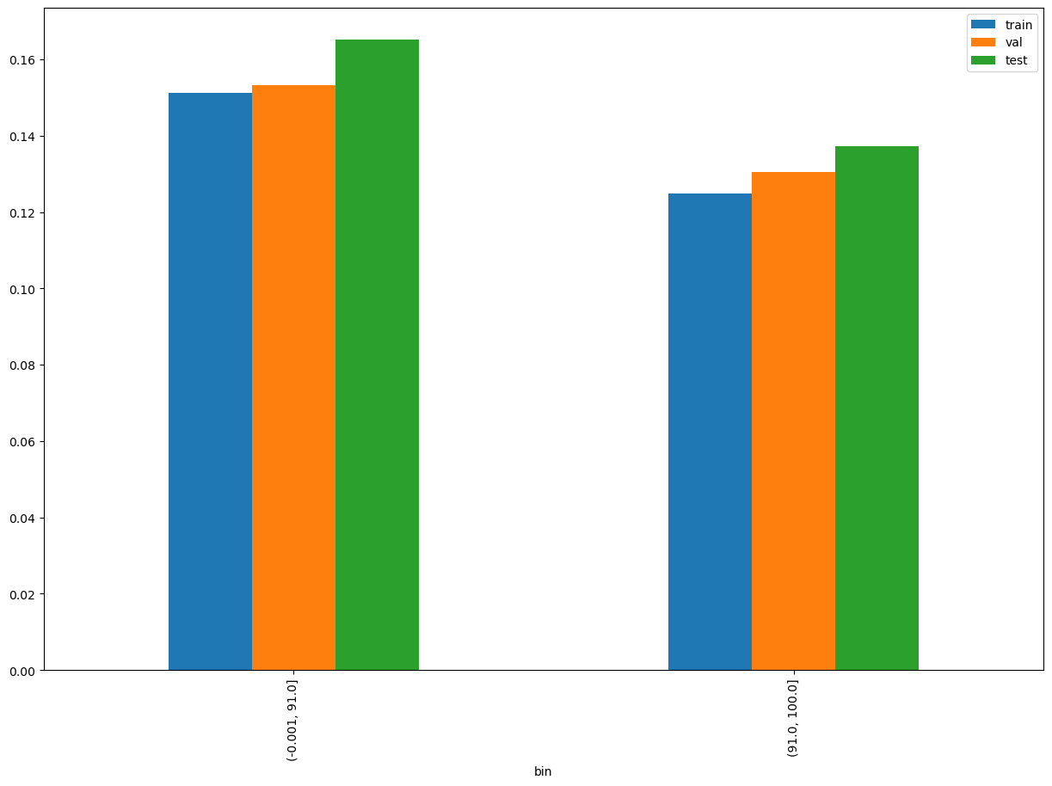

sb_de_onb_name_email_match_score

Slide 19
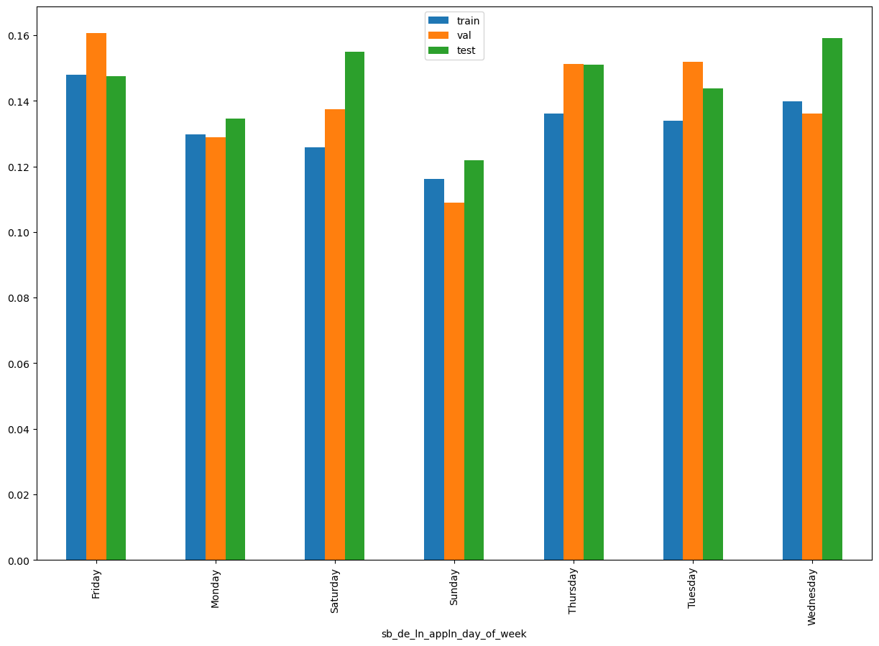
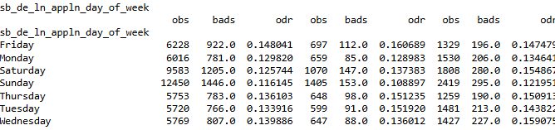
sb_de_ln_appln_day_of_week

Slide 20
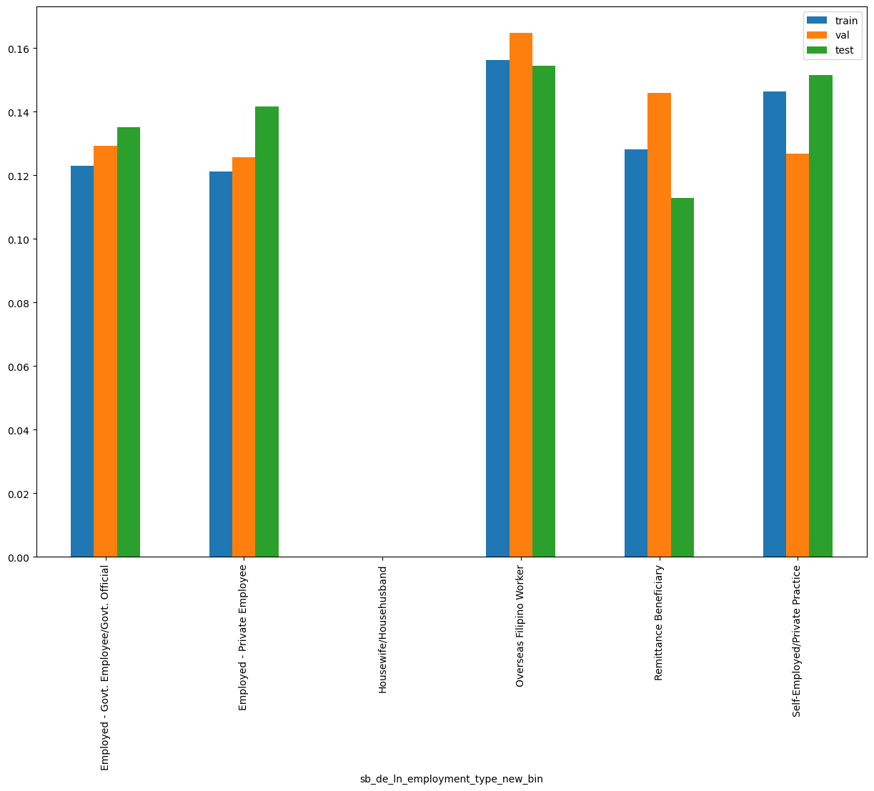
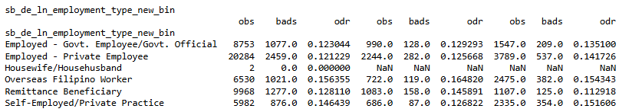
sb_de_ln_employment_type_new_bin

Slide 21
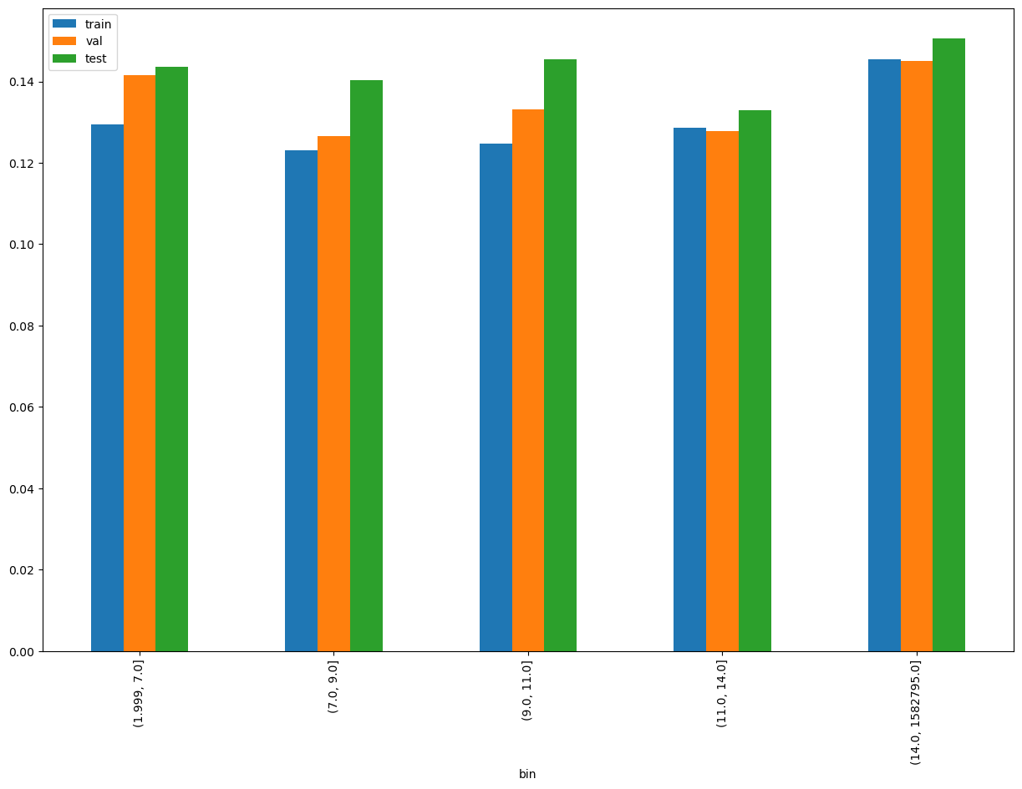
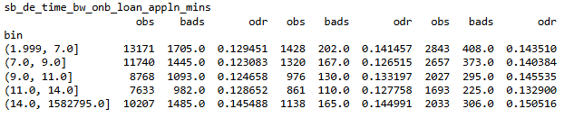
sb_de_time_bw_onb_loan_appln_mins

Slide 22
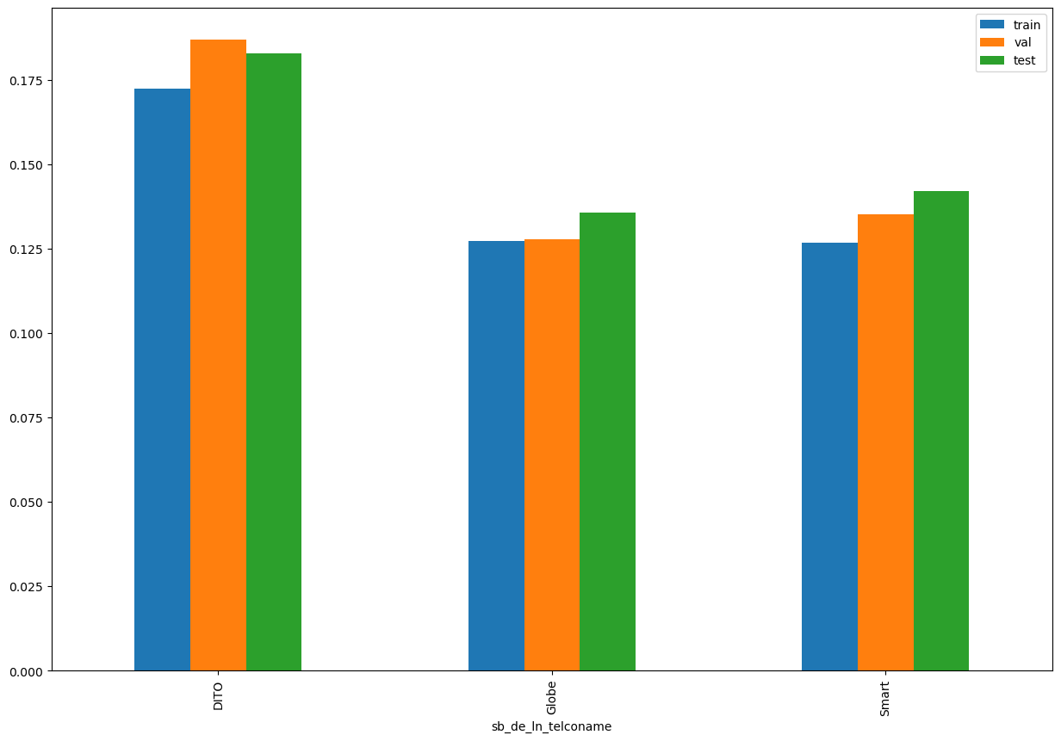

sb_de_ln_telconame

Slide 23
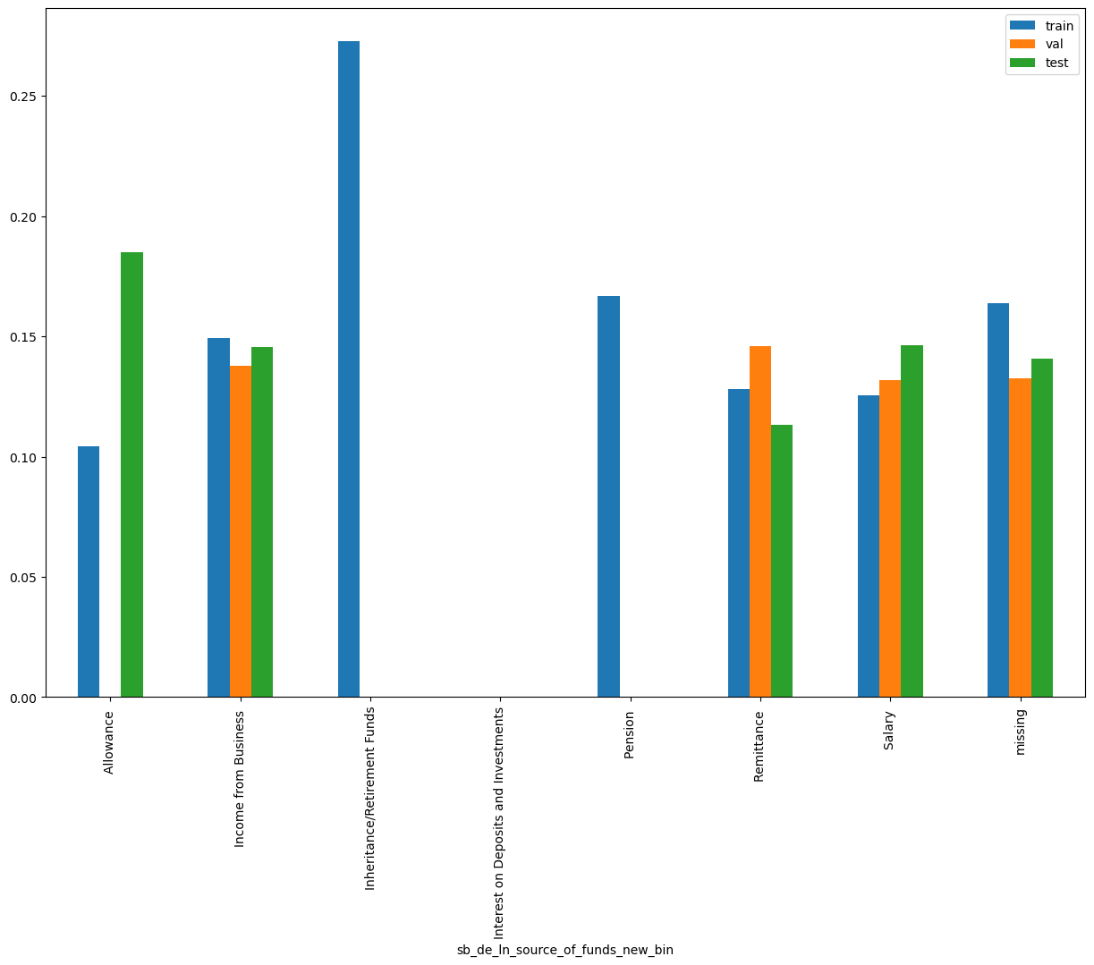
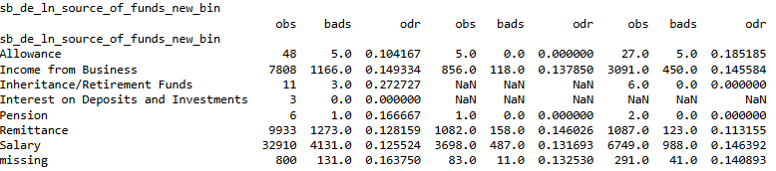
sb_de_ln_source_of_funds_new_bin

Slide 24
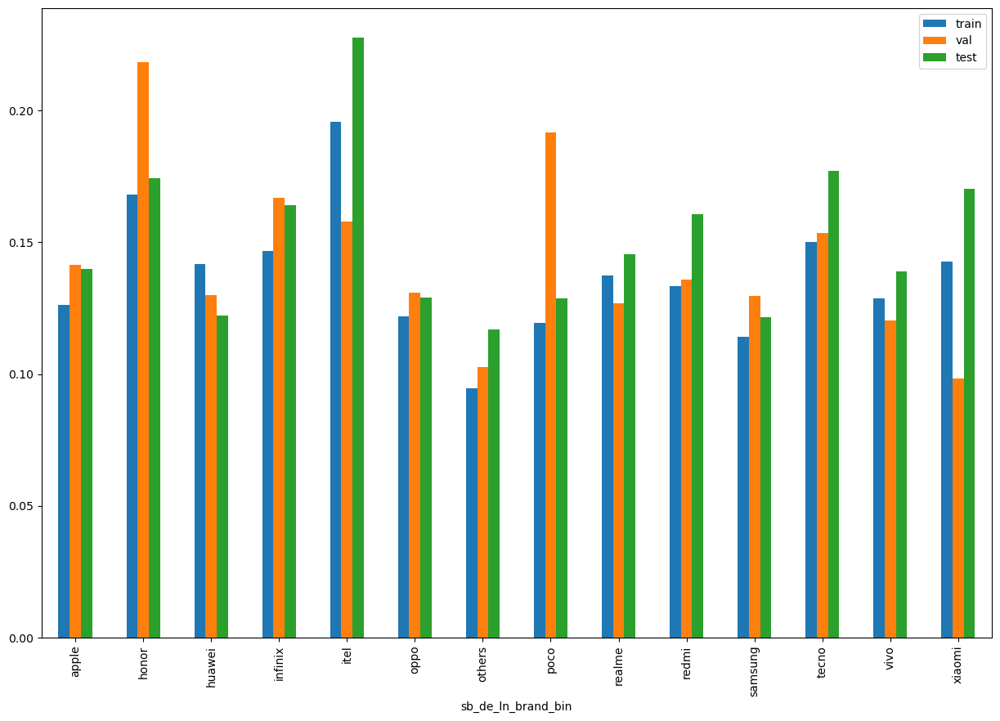
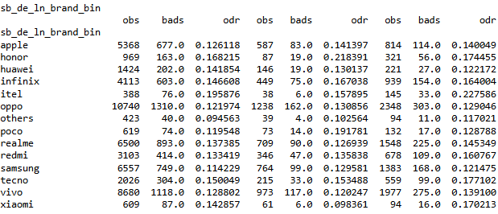
sb_de_ln_brand_bin

Slide 25
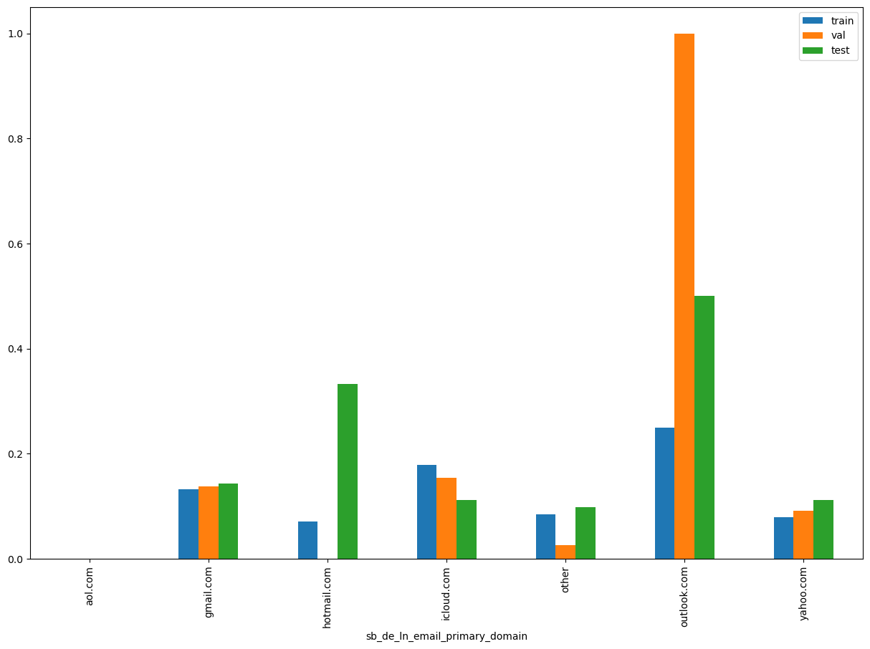
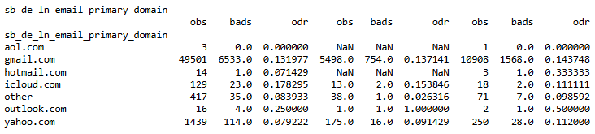
sb_de_ln_email_primary_domain

